Slide 1

Card Games Testing
By Kenny Chung, Jeremiah Hadwin, Chenxin Zhu

Slide 2
What is the Card Games app?
An open-source Java-based desktop application to play various card games
Blackjack, 5-hand Poker, Texas Holdem Poker, High-Low
Purpose: Used for playing, testing, and demonstrating card game logic and GUI interactions

Slide 3
Kind of app & Platforms
Desktop Application
Built with Java Swing GUI Framework
Runs on any platform with a Java runtime environment
Windows, MacOS, Linux

Slide 4
Potential users
Users of all age groups who enjoy classic card games
Java developers learning GUI testing
Educational users learning game logic

Slide 5
Technologies & languages
Java Programming Language
Java Swing for GUI
JFrame for the main window
JButton for clickable buttons
JLabel for text and image display
JPanel for organizing components
JTextField for text input
Uses custom Deck, Card, PokerHand, BJHand classes
AWT (Abstract Window Toolkit): Java's original platform-dependent GUI toolkit
Colors (Color class)

Slide 6
CLASSES for testing
Client
Runnable
Poker
VisualBJ
TexasHoldem
VisualHL
Hand
Deck
Helper
BJHand
PokerHand
Card

Slide 7
Blackbox testing
Read comments + Understand game rules

Slide 8
Randomness testing results
Deck: Shuffle()
30000 runs
For each pair (Card, Position)
+50%/-50%

Slide 9
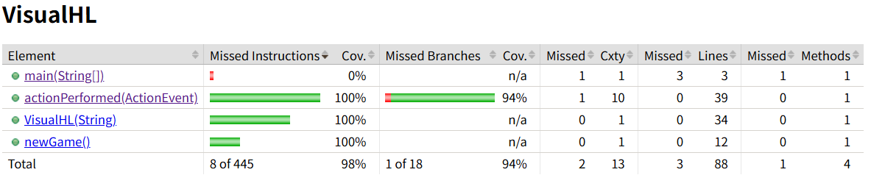
Whitebox testing results (Visualhl)

Slide 10

Whitebox testing results (Visualhl)
New Game, Higher, Lower

Slide 11
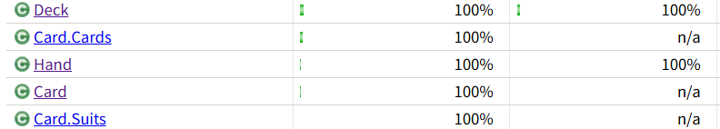
Whitebox testing results (Deck, hand)

Slide 12
Whitebox testing results (Deck, hand)
Test Class | Failure Method | Fault
Hand | boolean addCard(Card c) | It does not return false when adding duplicate card.
Hand | void removeCard(Card c) | It does not handle the case when the card c does not exist in the hand
Card | getCardNumber() | Ambiguous, index or real card number? No value for Ace as one.

Slide 13
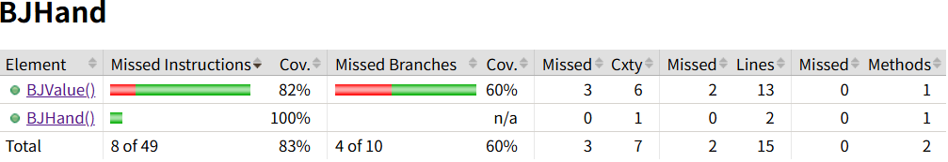
Whitebox testing results (BJhand)

Slide 14
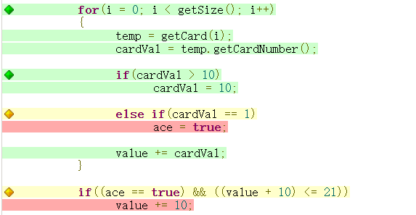
Whitebox testing results (BJhand)

Slide 15
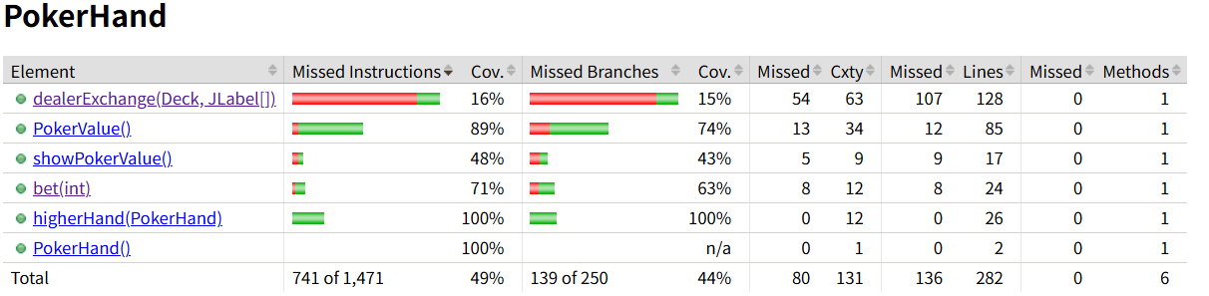
Whitebox testing results (Pokerhand)

Slide 16
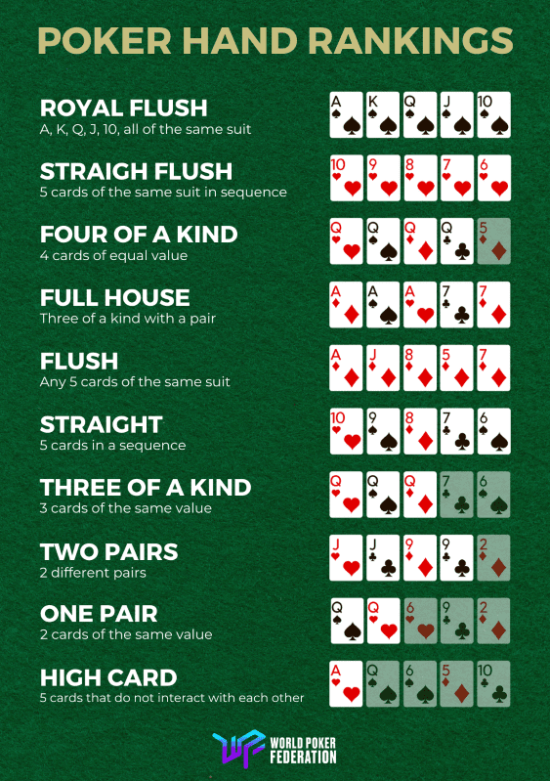
Whitebox testing results (Pokerhand)

Slide 17
Whitebox testing results (Pokerhand)
Test Class | Failure Method | Fault
PokerHand | pv[] PokerValue() | Incorrect use of getSuit() and getCardNumber().
PokerHand | String showPokerValue() | Use PokerValue()
PokerHand | void dealerExchange(...) | Use PokerValue(), getSuit() and getCardNumber()
PokerHand | int bet(int amount) | User PokerValue, does not check negative input.
PokerHand | int higherHand(PokerHand ph) | Does not check the case of different sizes.

Slide 18
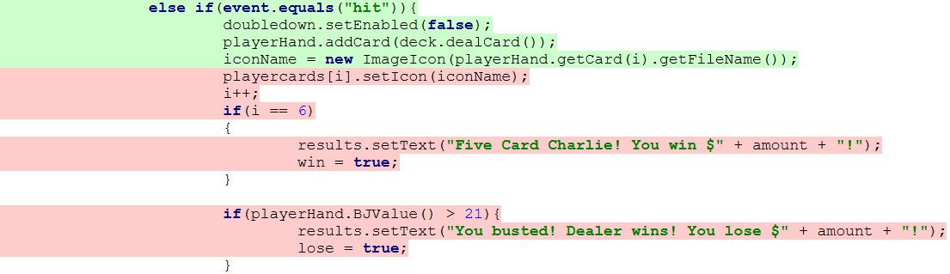
White box testing results (BlackJack)

Slide 19
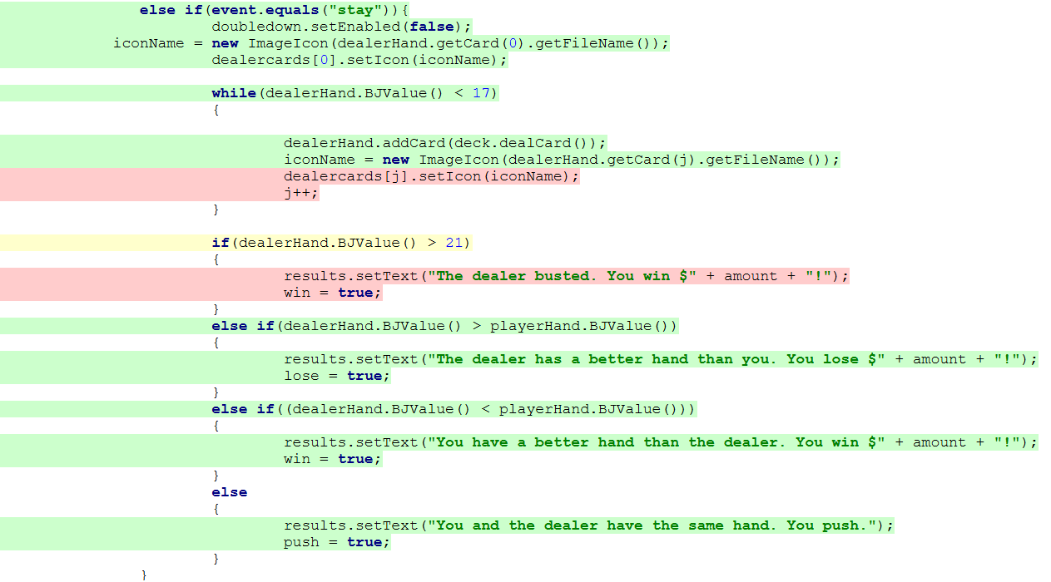
White box testing results (BlackJack)

Slide 20
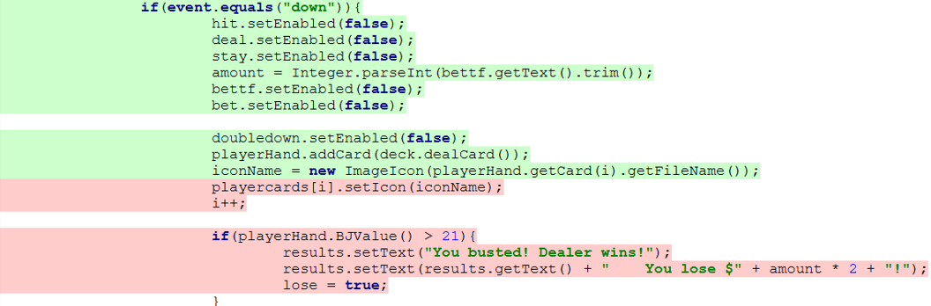
White box testing results (BlackJack)

Slide 21
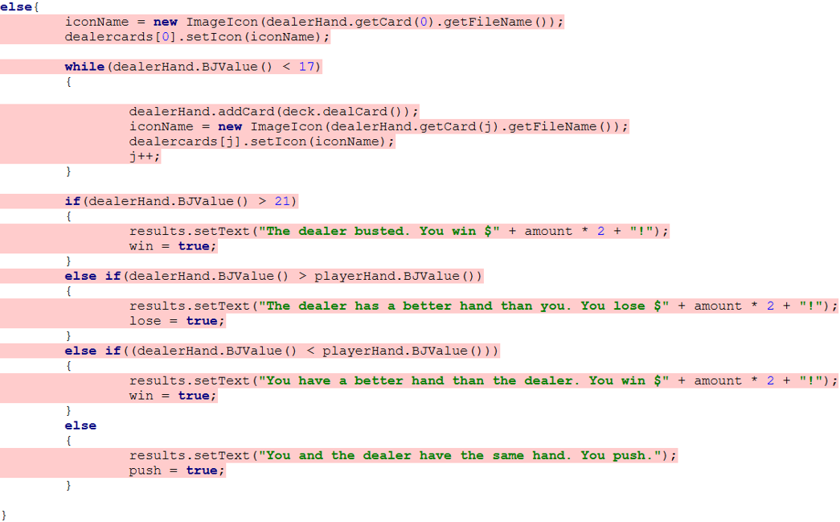
White box testing results (BlackJack)

Slide 22
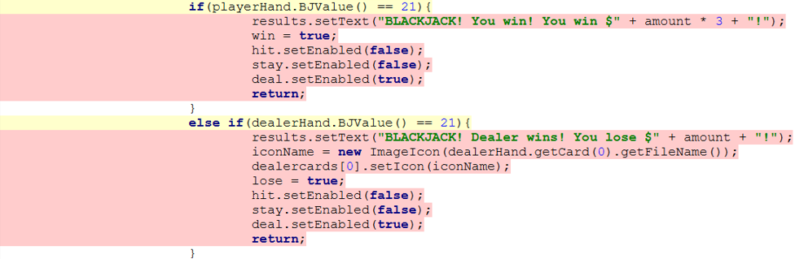
White box testing results (BlackJack)

Slide 23
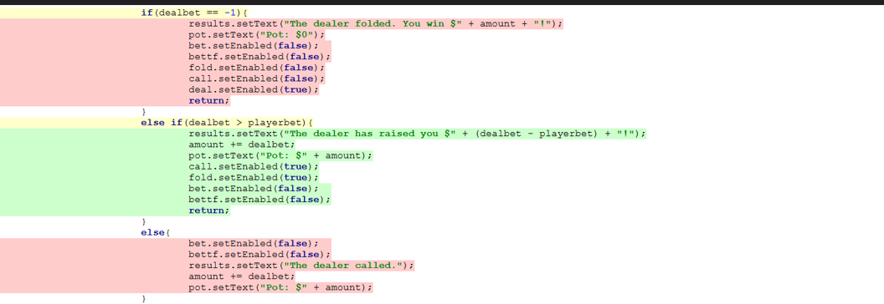
White box testing results (5-Hand Poker)

Slide 24
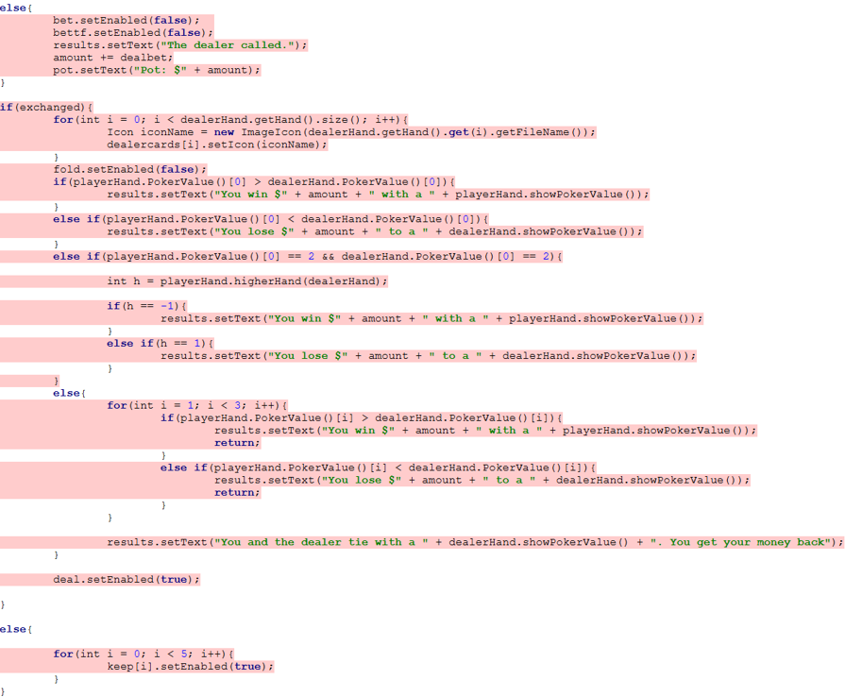
White box testing results (5-Hand Poker)

Slide 25
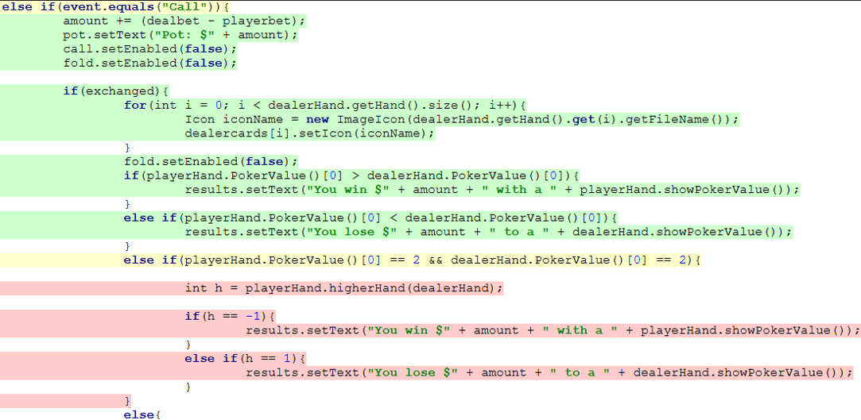
White box testing results (5-Hand Poker)

Slide 26
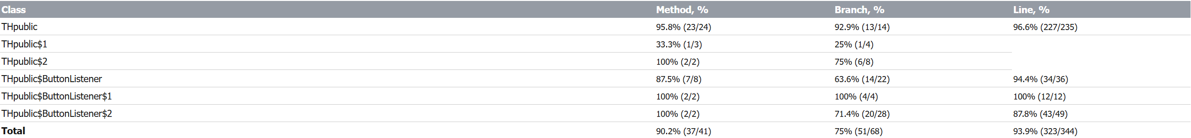
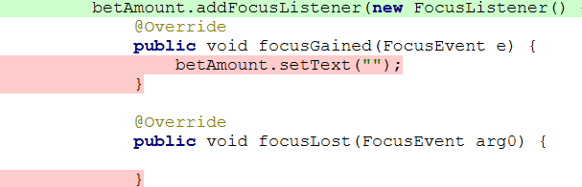
White box testing results (Texas Holdem)

Slide 27

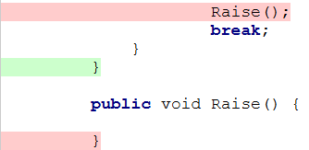
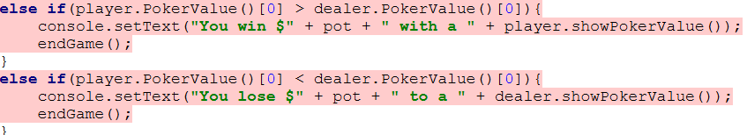
White box testing results (Texas Holdem)

Slide 28
REFLECTION
Faults:
All hands are flushes in poker.
Lots of early stopping.
Blackjack index errors.
Blackjack value errors.
Texas Holdem Bet handling
Blackbox

Slide 29
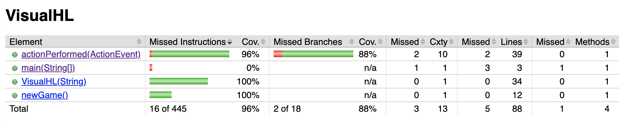
GUI testing results (HIgh-low)

Slide 30
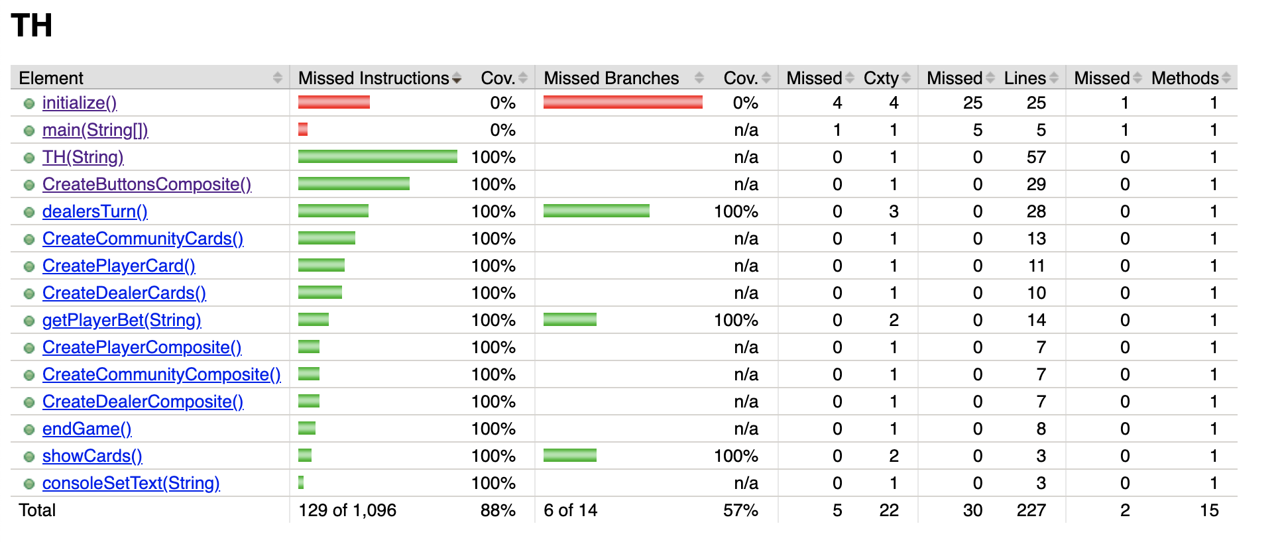
GUI testing results (Texas holdem)

Slide 31
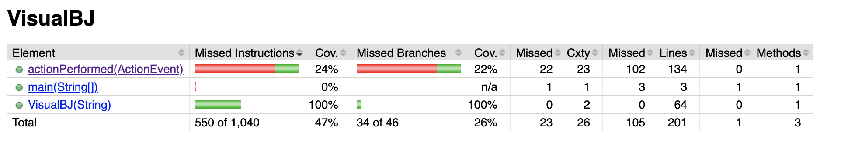
GUI testing results (Blackjack)

Slide 32
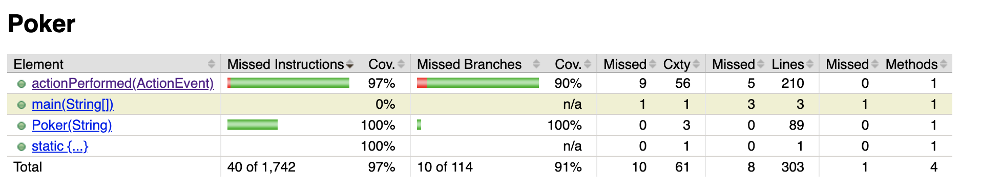
GUI testing results (5-hand poker)

Slide 33
REFLECTION
Faults:
Blackjack buttons are present but don't work
Game gets concluded for Texas Holdem game after final card
Initial card for High-Low doesn't show up
Lesson:
Learned how to utilize Mockito to inject a mock Pokerhand
Components sometimes don't register in time

Slide 34
Conclusion
Blackbox and Whitebox testing for all the classes.
Randomness testing for methods that use random().
GUI testing for each game.
Good coverage level for classes with no or a few faults.

